Slide 1
Nova Data Flow
Emma McKnight, Declan Macken

Slide 2
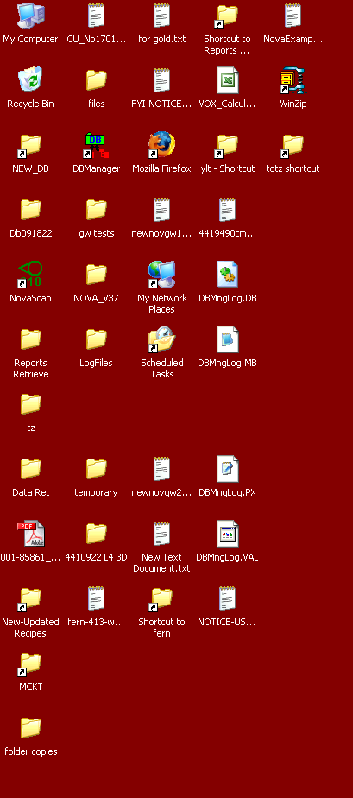

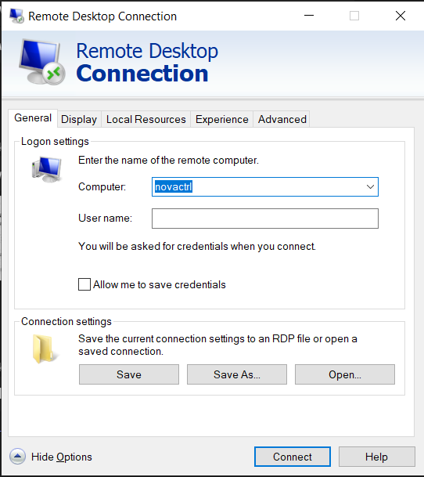
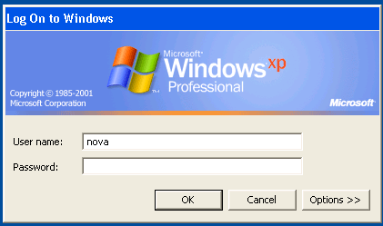
Remote Desktop: Log In
User name: nova
Password: ns840

Slide 3
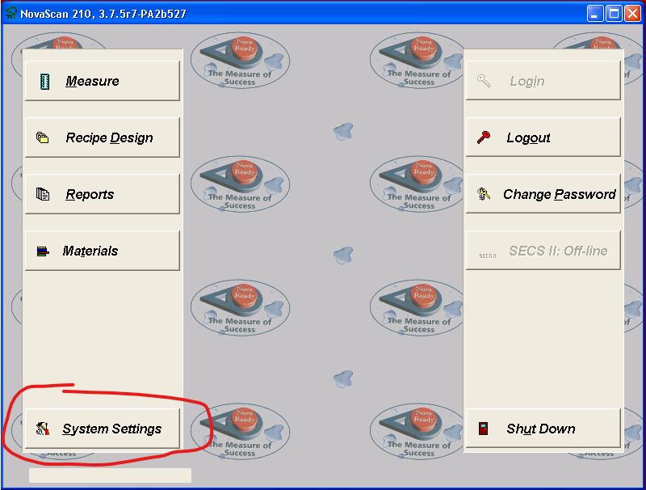
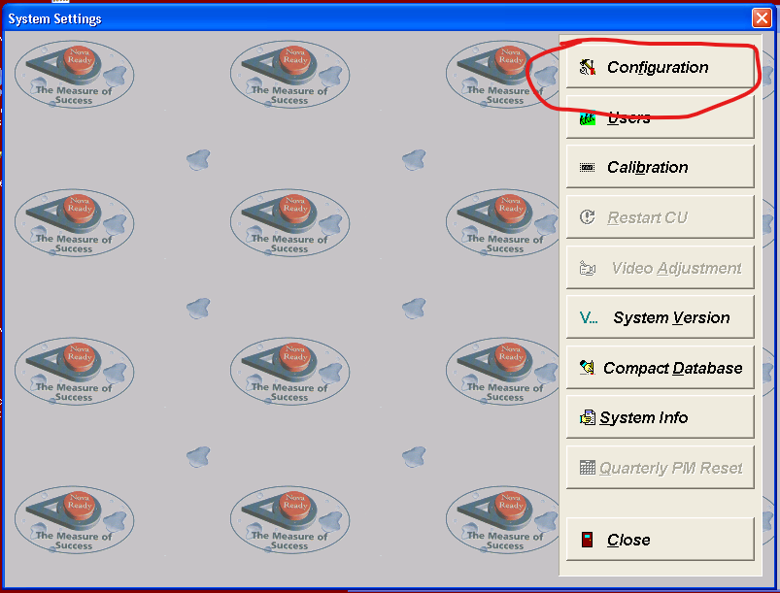
Remote Desktop: Update

Slide 4
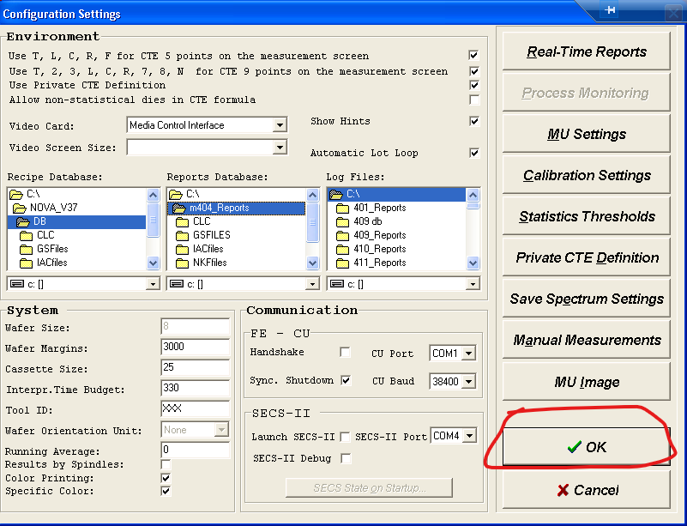
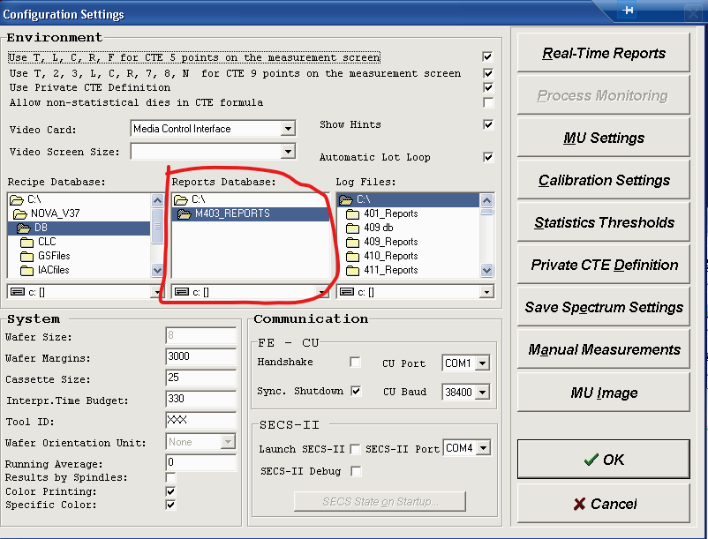
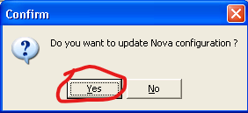
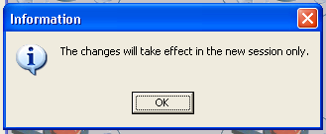
Remote Desktop: Update
In this window navigate to the right folder by going up to C:\ and then choosing the appropriately named reports folder.
Hit okay, close out of the novascan program completely and reopen.

Slide 5
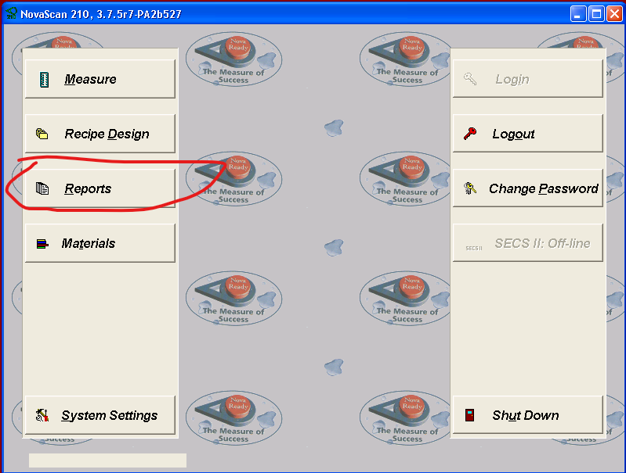


Remote Desktop: Create Report

Slide 6
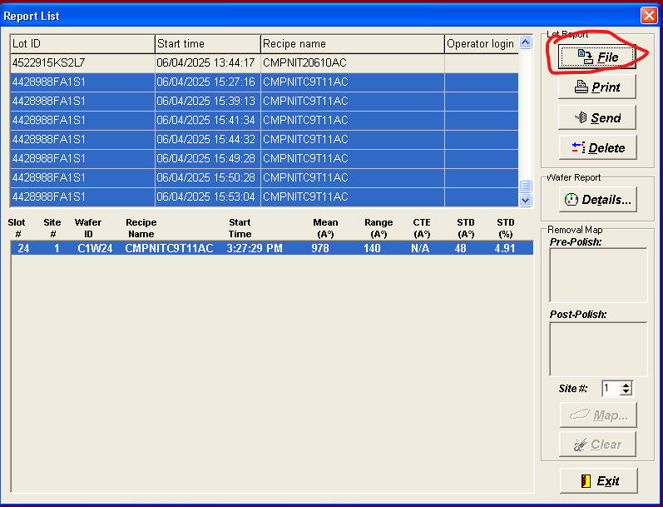
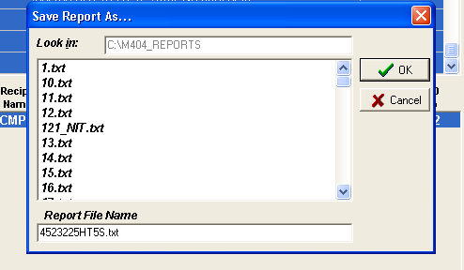
Remote Desktop: Create Report
Choose the appropriate files and select them, then hit file, save with whatever name you want (1.txt shown).
Note what folder its saving to (C:\M404_REPORTS shown).
Go to that folder, move the file to whichever network spot you want.
Note: the local folder for files sometimes refreshes itself and will delete saved txt files in the process, so move the file somewhat quickly from the folder to your ufiles (or other network location).

Slide 7
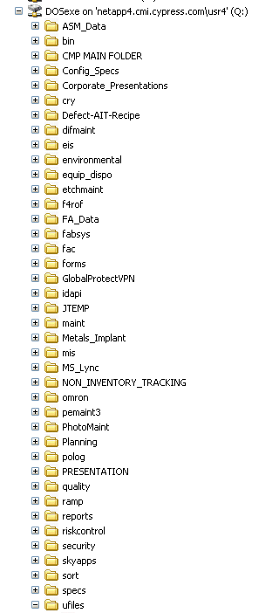
ufiles Location
On the remote PC, the shared directory is labelled Q:
Save the data here and close the Remote Desktop.

Slide 8
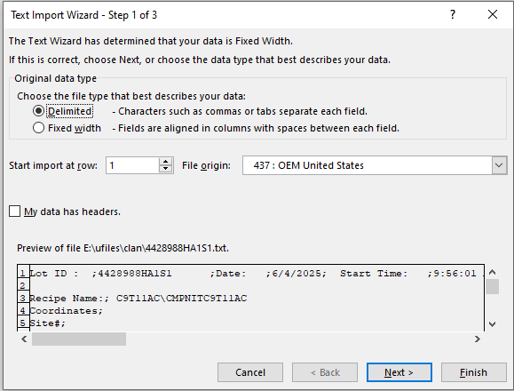
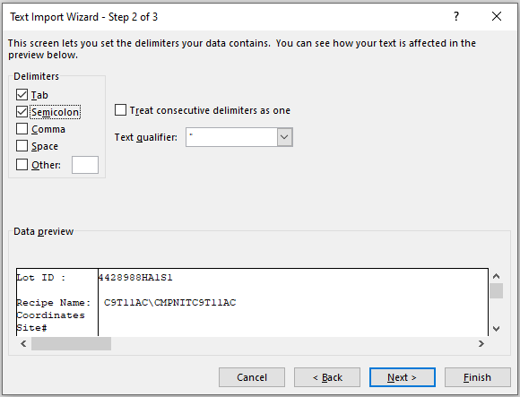
Excel Import
Excel Import and Save is needed to create the preferred format.
Import without headers using Tab and Semicolons as delimiters.

Slide 9
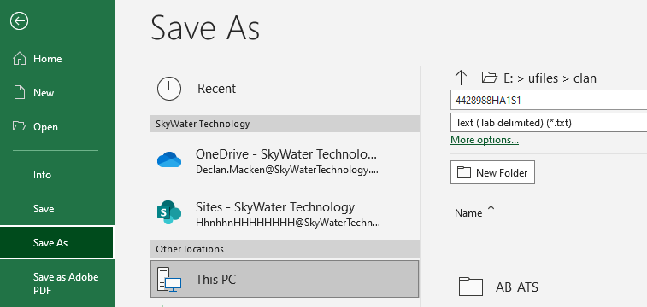
Excel Save
Save as a text (Tab delimited) file.

Slide 10
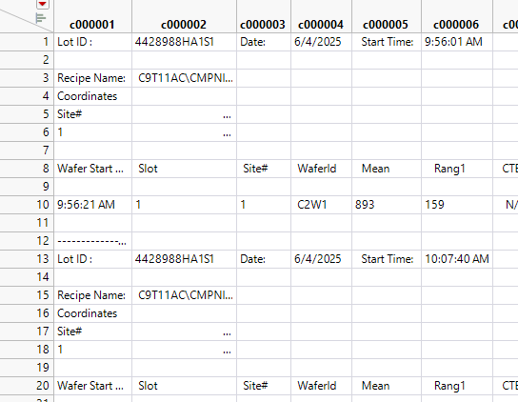
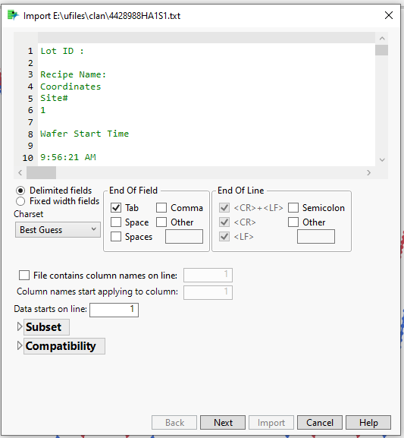
JMP
Import into JMP without column names and Tabs as end of field

Slide 11
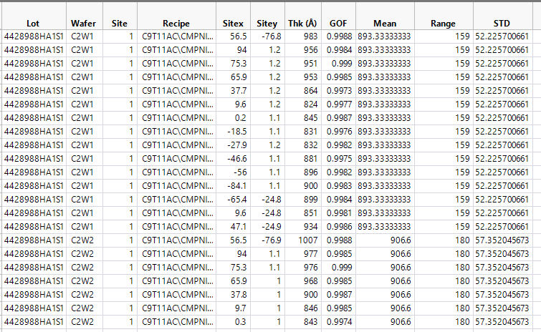
JMP
Once imported run the Nova JMP script.
Finished result shown right

